Slide 1

Health Care
By: Keanu Chetty, Abhishek Patel, Mason Ayres

Slide 2
Database overview / scope description
We will create a Database that will be designed to be implemented in a hospital setting.
We will use the Database to store information, this information will be entered routinely and will be the hospitals clinical and laboratory data.
Our Database will also store the patients and doctors’ information as well as what department of the hospital the patient is currently in.
The purpose of this Database is not only to allow doctors and nurses to access the patient’s nformation quite quickly, but the Database should also be able to provide information that will allow the hospital to review their quality of healthcare and use this information to focus on the quality provided by the different sections of the hospital and review the quality of the different sections.
This Database should be able to focus on both the patient and the hospital and allow the hospital to create the best healthcare environment possible.

Slide 3
DATABASE OVERVIEW / SCOPE DESCRIPTION
Each Patient should have a unique username and patient ID
Employees will have Unique ID numbers
Patient Information will contain a Social Security Number that is Unique
Nurses have access to record information for the patient information
Every Patient account is linked to patient information and Visit History, patient information contains Gender, Health Conditions, medication, insurance, SSN, Address, Pharmacy, treatment, first name, last name, Room number.
Every patient has to have a patient account so that the patient information can be recorded and accessed by the Employees
Employees are within department

Slide 4
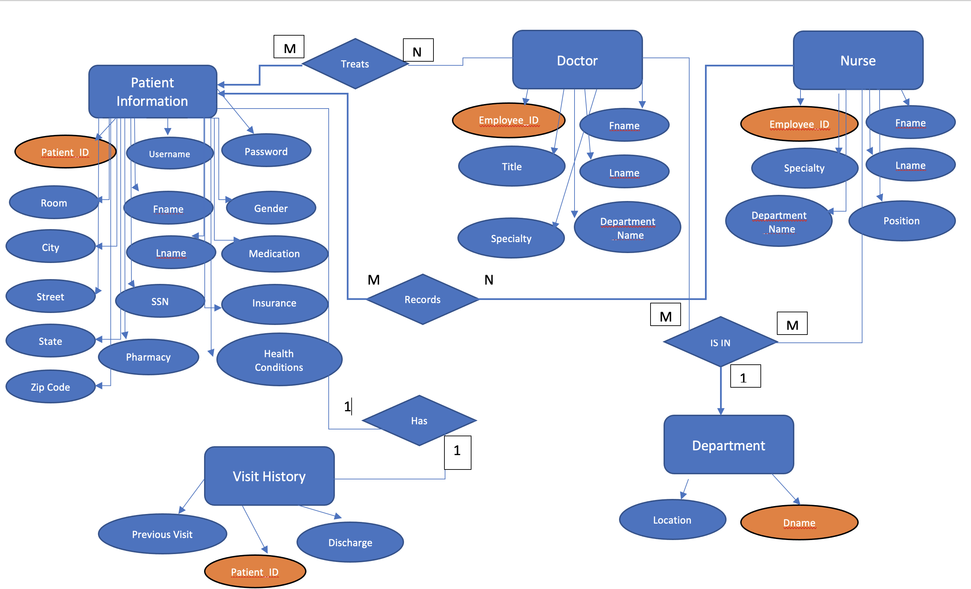
Database design /ER&EER
Image of Our ER Diagram

Slide 5
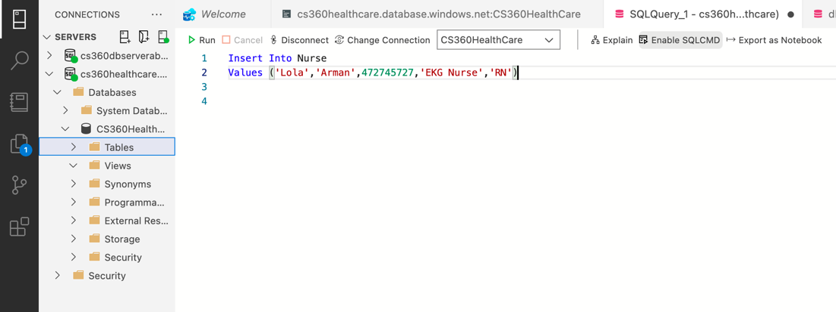
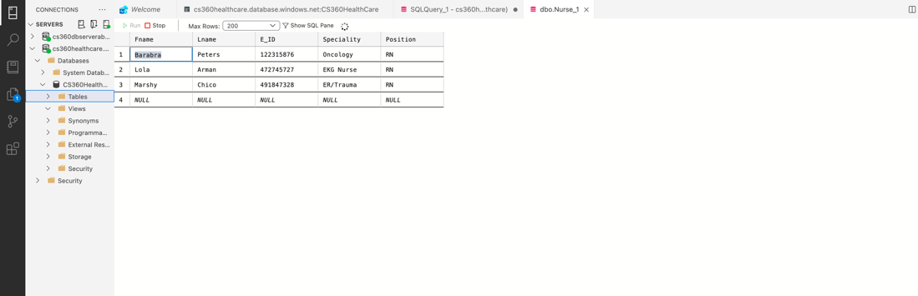
Database implementation/SQL statements and tables.
Insert Into NurseValues ('Lola','Arman',472745727,'EKG Nurse','RN'),
Insert (Fname, lname, id, specialty, position)

Slide 6
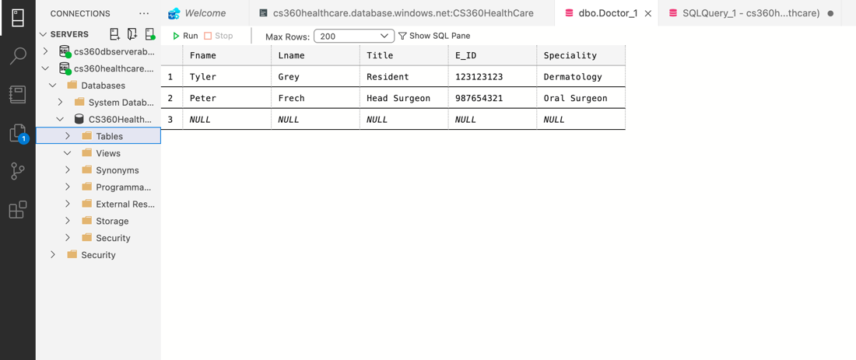
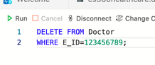
Database implementation/SQL statements and tables.
DELETE FROM Doctor
WHERE E_ID= 123456789;
Delete

Slide 7
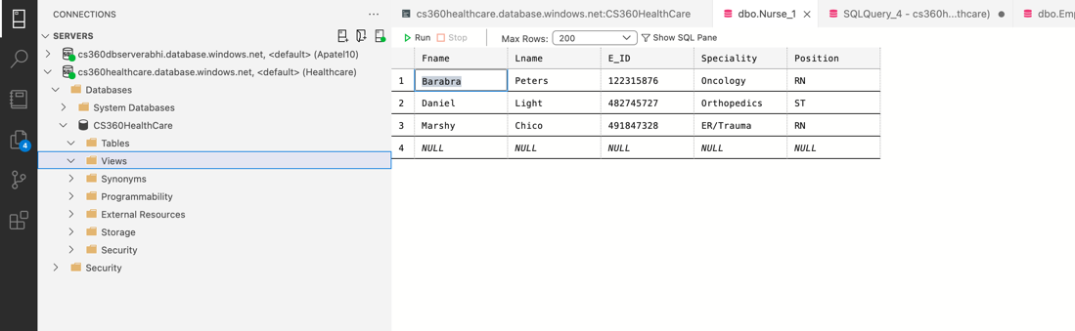
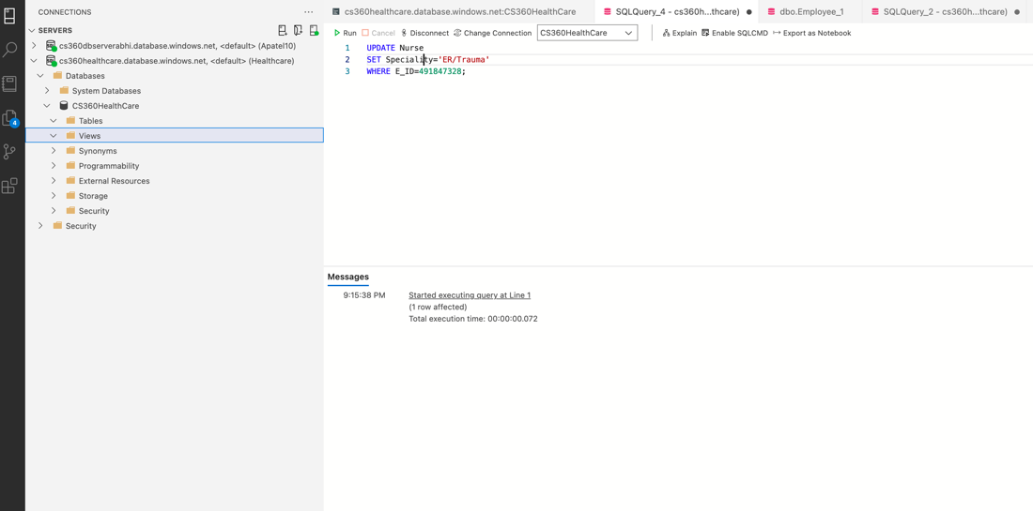
Database implementation/SQL statements and tables.
UPDATE NurseSET Specialty=’ER/Trauma’WHERE E_ID=491847328;
Update

Slide 8
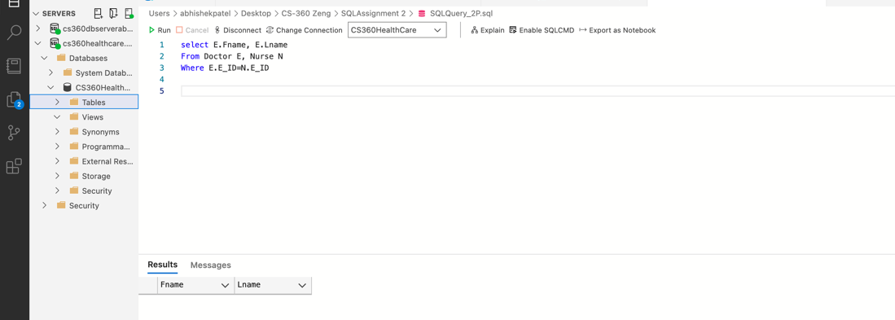
Database implementation/SQL statements and tables.
select E.Fname, E.Lname
From Doctor E, Nurse N
Where E.E_ID=N.E_ID
Select

Slide 9

Our Database

Slide 10
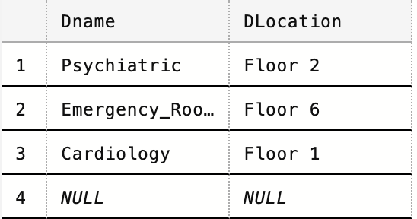
Department

Slide 11
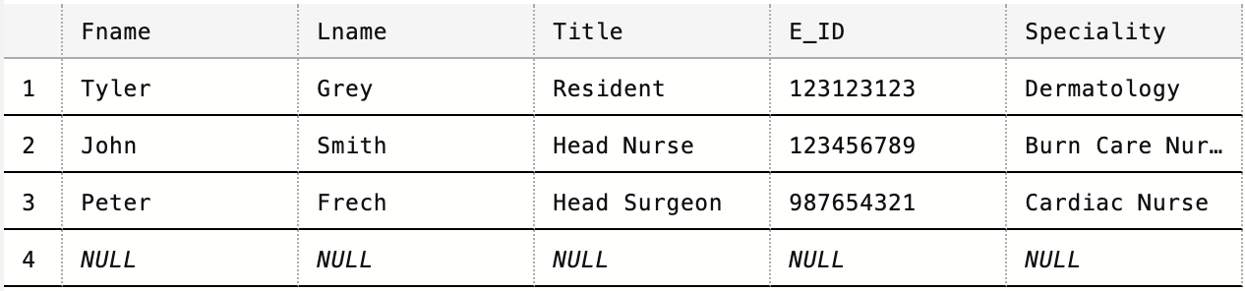
Doctor

Slide 12
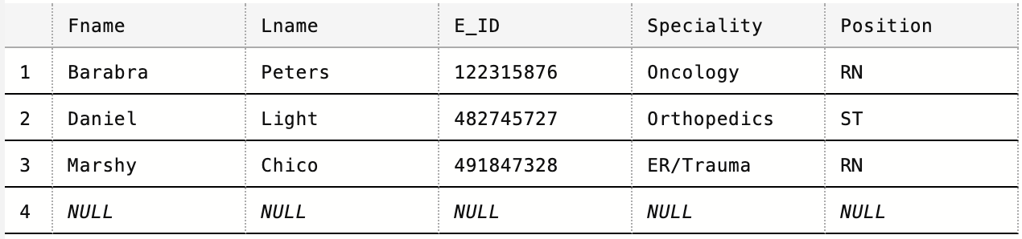
Nurse

Slide 13
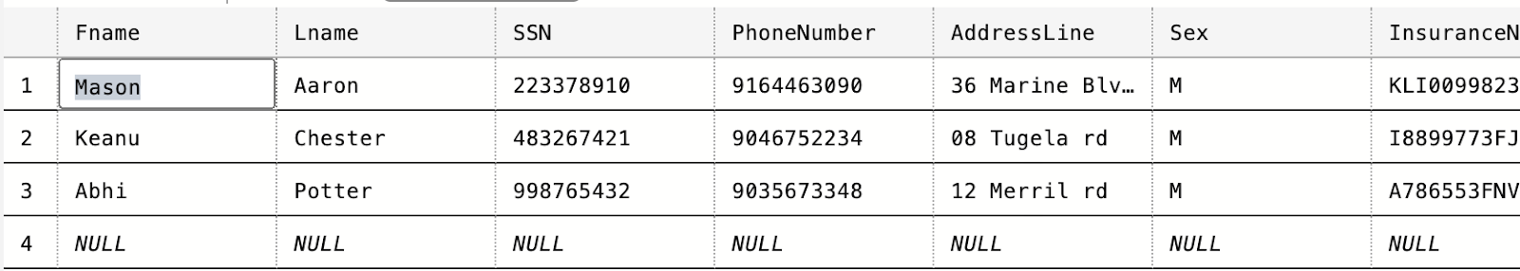
Patient Information

Slide 14
Visit History

Slide 15
Thank you!

